Slide 1
MATRICES
MATH 15 - Linear Algebra

Slide 2
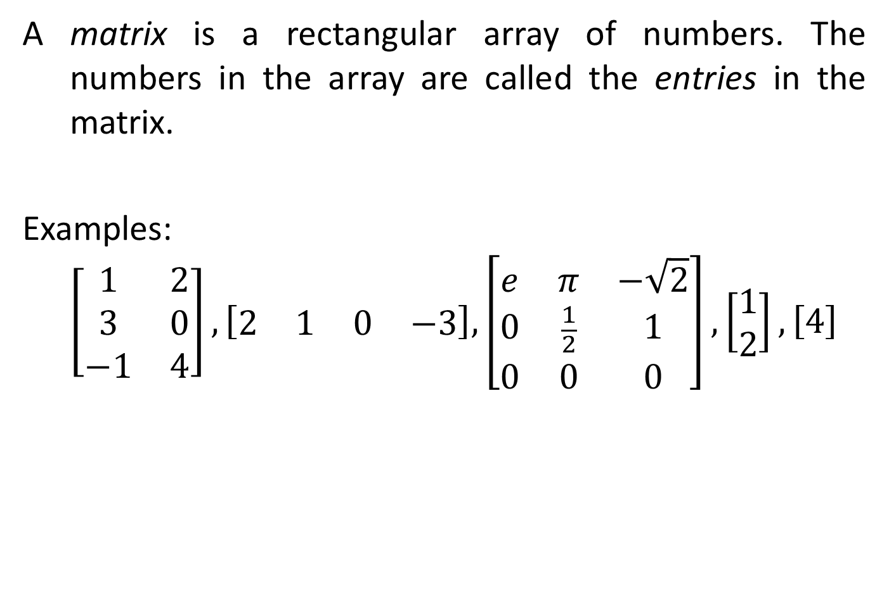
MATRICES
A matrix is a rectangular array of numbers. The numbers in the array are called the entries in the matrix.
Examples:
$$\left[\begin{matrix}1 & 2 \\ 3 & 0 \\ −1 & 4\end{matrix}\right], \left[\begin{matrix}2 & 1 & 0 & −3\end{matrix}\right], \left[\begin{matrix}e & π & −\sqrt{2} \\ 0 & \frac{1}{2} & 1 \\ 0 & 0 & 0\end{matrix}\right], \left[\begin{matrix}1 \\ 2\end{matrix}\right], \left[4\right]$$

Slide 3
MATRICES
The size of a matrix is described in terms of the number of rows (horizontal lines) and columns (vertical lines) it contains. For example, the first matrix in Example 1 has three rows and two columns, so its size is 3 by 2 (written 3 × 2). In a size description, the first number always denotes the number of rows, and the second denotes the number of columns.

Slide 4
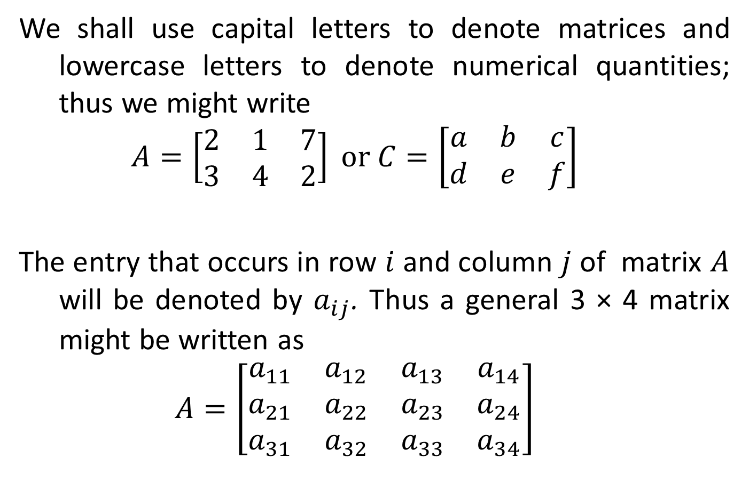
MATRICES
We shall use capital letters to denote matrices and lowercase letters to denote numerical quantities; thus we might write
$$A=\left[\begin{matrix}2 & 1 & 7 \\ 3 & 4 & 2\end{matrix}\right] or C=\left[\begin{matrix}a & b & c \\ d & e & f\end{matrix}\right]$$
The entry that occurs in row $i$ and column $j$ of matrix $A$ will be denoted by $a_{ij}$. Thus a general 3 × 4 matrix might be written as
$$A=\left[\begin{matrix}a_{11} & a_{12} & a_{13} & a_{14} \\ a_{21} & a_{22} & a_{23} & a_{24} \\ a_{31} & a_{32} & a_{33} & a_{34}\end{matrix}\right]$$

Slide 5
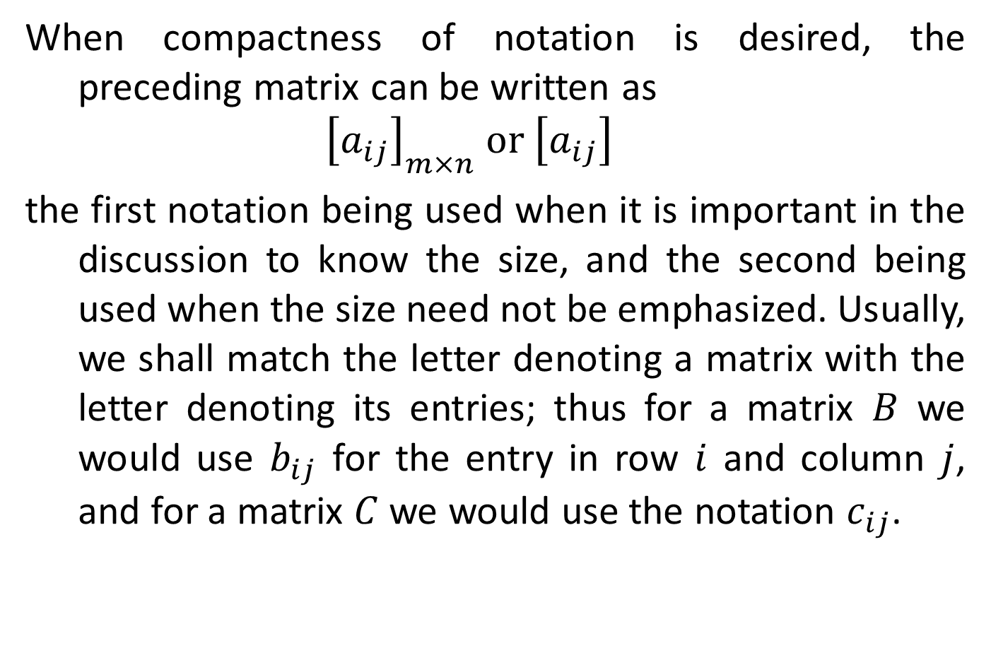
MATRICES
When compactness of notation is desired, the preceding matrix can be written as
$${\left[a_{ij}\right]}_{m×n} or \left[a_{ij}\right]$$
the first notation being used when it is important in the discussion to know the size, and the second being used when the size need not be emphasized. Usually, we shall match the letter denoting a matrix with the letter denoting its entries; thus for a matrix $B$ we would use $b_{ij}$ for the entry in row $i$ and column $j$, and for a matrix $C$ we would use the notation $c_{ij}$.

Slide 6
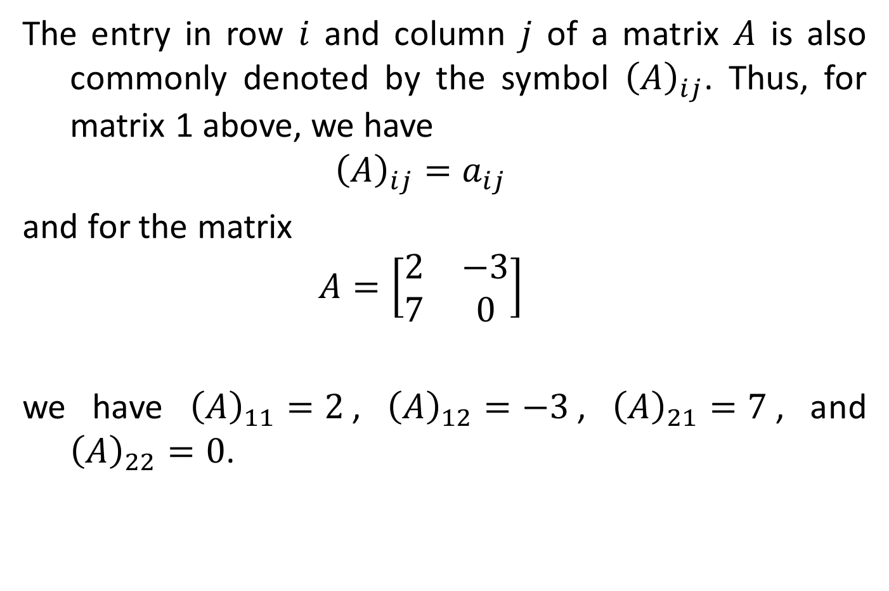
MATRICES
The entry in row $i$ and column $j$ of a matrix $A$ is also commonly denoted by the symbol ${\left(A\right)}_{ij}$. Thus, for matrix 1 above, we have
$${\left(A\right)}_{ij}=a_{ij}$$
and for the matrix
$$A=\left[\begin{matrix}2 & −3 \\ 7 & 0\end{matrix}\right]$$
we have ${\left(A\right)}_{11}=2$, ${\left(A\right)}_{12}=−3$, ${\left(A\right)}_{21}=7$, and ${\left(A\right)}_{22}=0$.

Slide 7
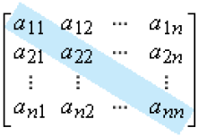

MATRICES
A matrix A with $n$ rows and $n$ columns is called a square matrix of order $n$, and the shaded entries $a_{11}, a_{22}, …, a_{nn}$ below are said to be on the main diagonal of $A$.

Slide 8
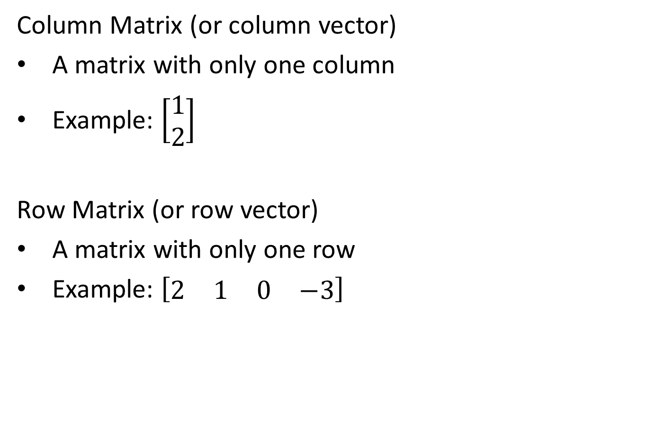
CLASSIFICATION OF MATRICES
Column Matrix (or column vector)
A matrix with only one column
Example: $\left[\begin{matrix}1 \\ 2\end{matrix}\right]$
Row Matrix (or row vector)
A matrix with only one row
Example: $\left[\begin{matrix}2 & 1 & 0 & −3\end{matrix}\right]$

Slide 9
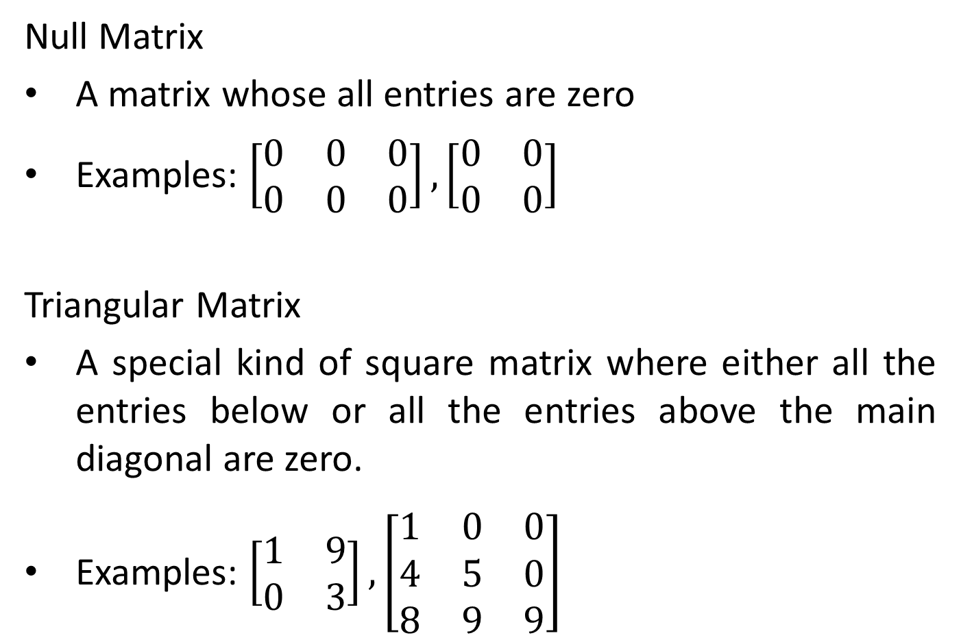
CLASSIFICATION OF MATRICES
Null Matrix
A matrix whose all entries are zero
Examples: $\left[\begin{matrix}0 & 0 & 0 \\ 0 & 0 & 0\end{matrix}\right], \left[\begin{matrix}0 & 0 \\ 0 & 0\end{matrix}\right]$
Triangular Matrix
A special kind of square matrix where either all the entries below or all the entries above the main diagonal are zero.
Examples: $\left[\begin{matrix}1 & 9 \\ 0 & 3\end{matrix}\right], \left[\begin{matrix}1 & 0 & 0 \\ 4 & 5 & 0 \\ 8 & 9 & 9\end{matrix}\right]$

Slide 10
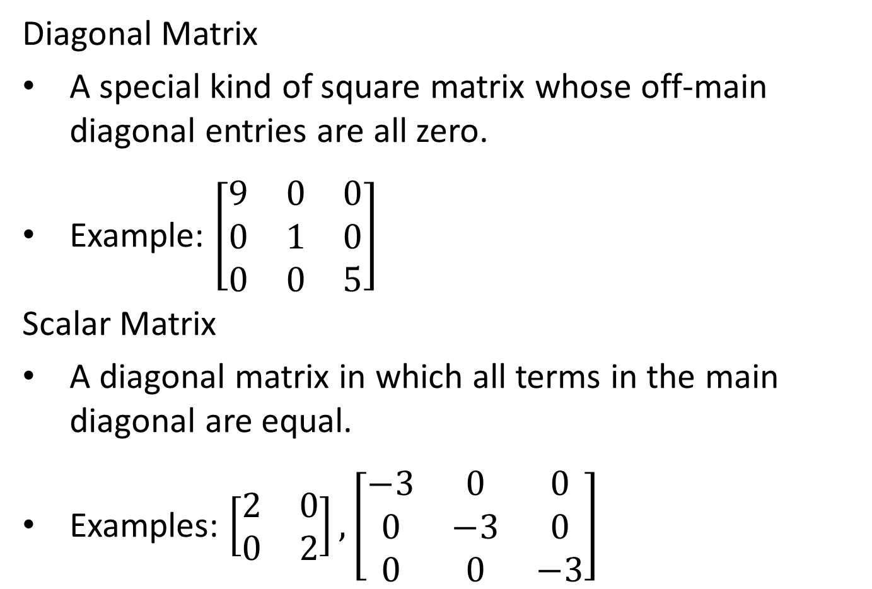
CLASSIFICATION OF MATRICES
Diagonal Matrix
A special kind of square matrix whose off-main diagonal entries are all zero.
Example: $\left[\begin{matrix}9 & 0 & 0 \\ 0 & 1 & 0 \\ 0 & 0 & 5\end{matrix}\right]$
Scalar Matrix
A diagonal matrix in which all terms in the main diagonal are equal.
Examples: $\left[\begin{matrix}2 & 0 \\ 0 & 2\end{matrix}\right], \left[\begin{matrix}−3 & 0 & 0 \\ 0 & −3 & 0 \\ 0 & 0 & −3\end{matrix}\right]$

Slide 11
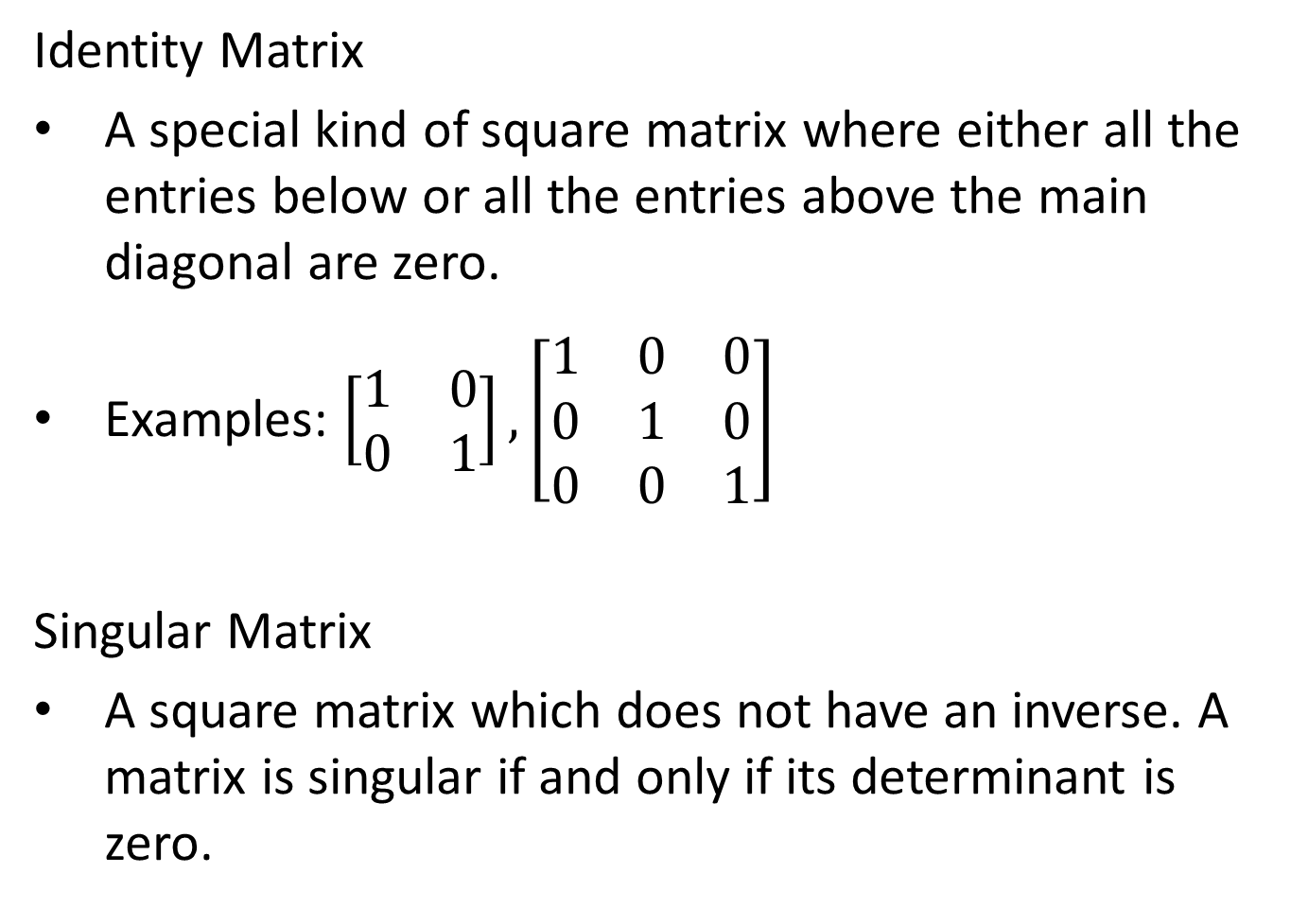
CLASSIFICATION OF MATRICES
Identity Matrix
A special kind of square matrix where either all the entries below or all the entries above the main diagonal are zero.
Examples: $\left[\begin{matrix}1 & 0 \\ 0 & 1\end{matrix}\right], \left[\begin{matrix}1 & 0 & 0 \\ 0 & 1 & 0 \\ 0 & 0 & 1\end{matrix}\right]$
Singular Matrix
A square matrix which does not have an inverse. A matrix is singular if and only if its determinant is zero.

Slide 12
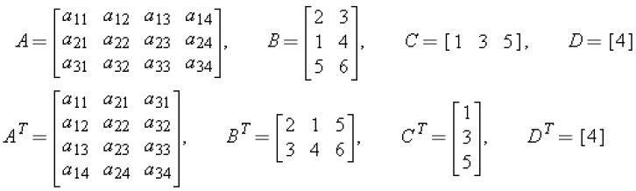

TRANSPOSE OF A MATRIX
If $A$ is any $m×n$ matrix, then the transpose of $A$, denoted by $A^{T}$, is defined to be the $n×m$ matrix that results from interchanging the rows and columns of $A$; that is, the first column of $A^{T}$ is the first row of $A$, the second column of $A^{T}$ is the second row of $A$, and so forth.
Examples:

Slide 13

CLASSIFICATION OF MATRICES
Symmetric Matrix
A special kind of square matrix that is equal to its transpose. ($A=A^{T}$)
Example: $\left[\begin{matrix}1 & 7 & 3 \\ 7 & 4 & −5 \\ 3 & −5 & 6\end{matrix}\right]$

